Slide 1
A Fourth-generation Laser for Ultrabroadband eXperiments (FLUX) for mitigation of LPI and beam imprint with bandwidth
Jonathan Zuegel
Director, Laser and Materials Technology Division
Laboratory for Laser Energetics
University of Rochester
41st Annual Fusion Power Associates
December 17, 2020

Slide 2
The FLUX concept leverages existing technology to deliver broadband UV laser pulses for mitigating laser-plasma instabilities (LPI) and improving uniformity
Summary
The FLUX program will address laser and physics challenges related to broadband optical pulses
FLUX relies on optical parametric amplification OPA and a novel sum-frequency-generation (SFG) scheme to generate spectrally incoherent, high-energy UV pulses
OPA and SFG stages use large-aperture KDP crystals
Diffraction gratings developed for Laser Megajoule (LMJ) provide angular dispersion required for efficient SFG and beam smoothing
A new FLUX pump laser system leverages existing LLE laser technology
The FLUX pump laser along with a booster amplifier will be delivered to the Matter at Extreme Conditions (MEC) at SLAC
NNSA and FES funding (coordinated with the ARPA-E BETHE program) enables FLUX laser system development and LPI mitigation experiments on OMEGA

Slide 3
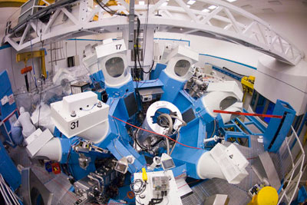
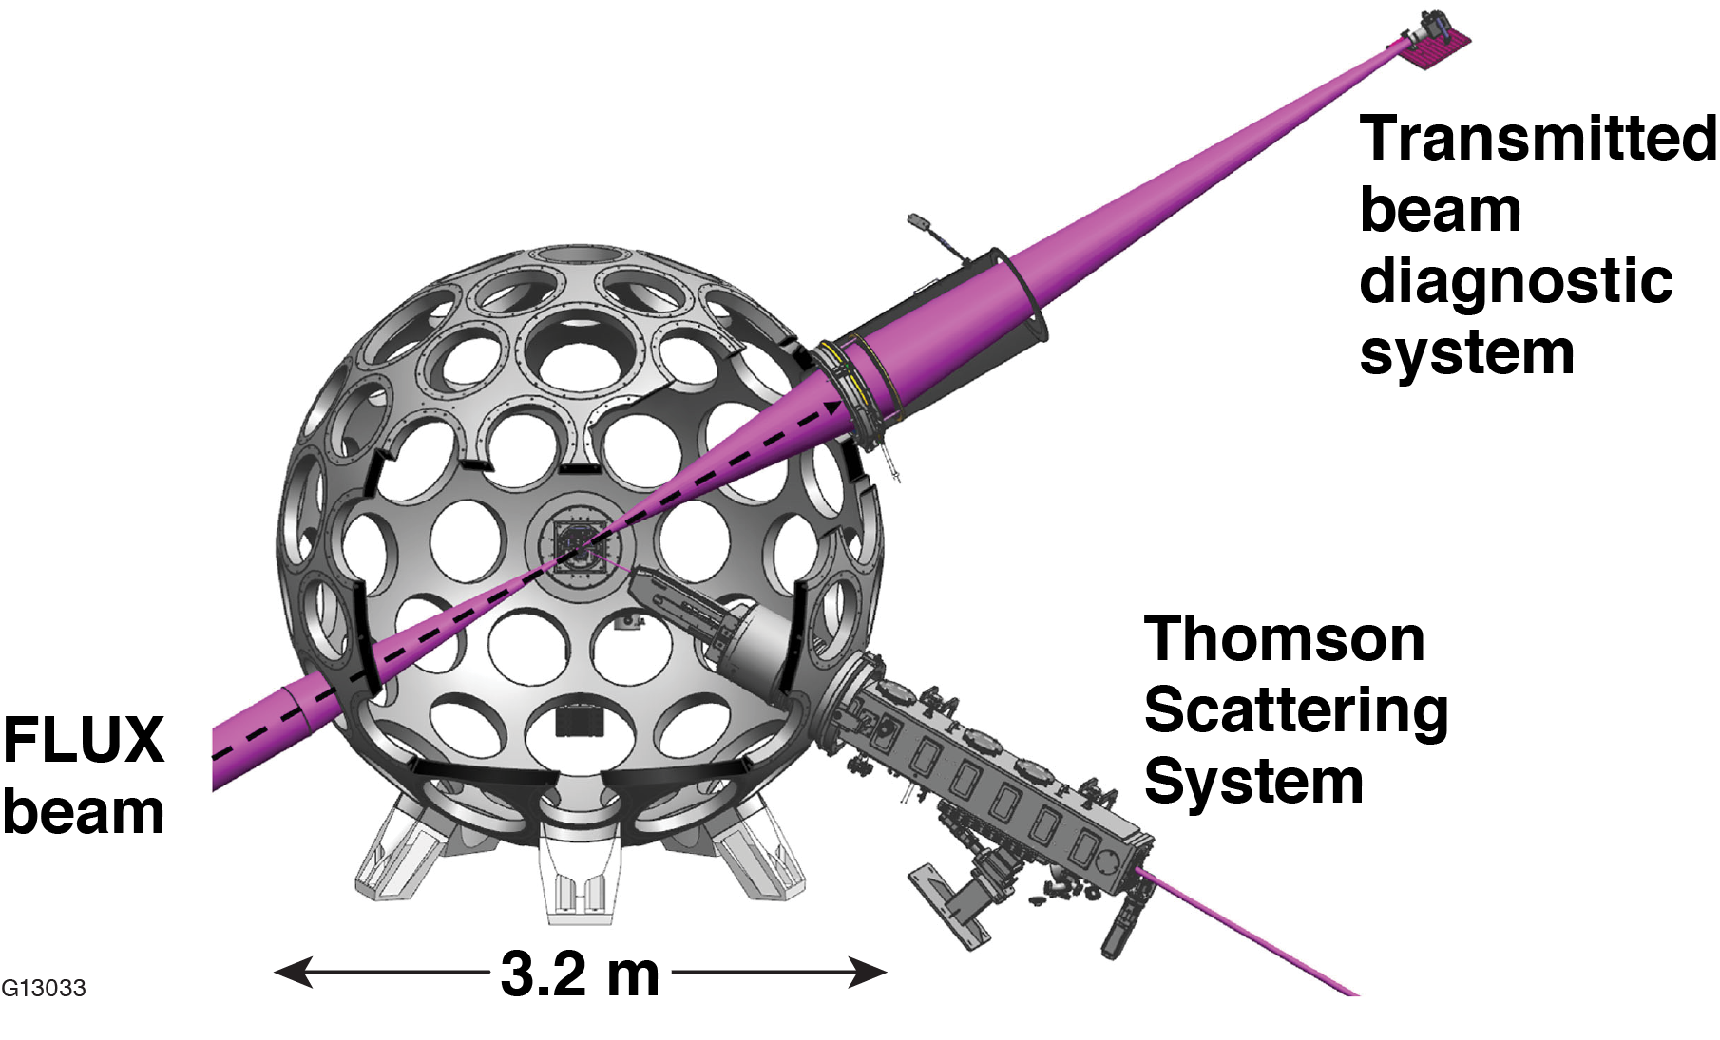
Experiments will use a FLUX laser to investigate LPI and beam imprint mitigation
OMEGA-60 target chamber
FLUX (Fourth-generation Laser for Ultrabroadband Experiments)
Physics requirement | Specification
Central wavelength | 351 nm (3$ω$)
Fractional bandwidth Δ$ω$/$ω0$ | 1.5%
Pulse duration/shape | 1.5 ns/flat in time
Energy | 150 J
On-target power | 0.1 TW
Far-field size | Focusable to 100 $μ$m (with distributed phase plates)
On-target intensity | 10¹⁵ W/cm²
The broadband spectrally incoherent FLUX pulses will be used with the 60 narrowband OMEGA pulses to support experiments, modeling capabilities, and technology for future ICF drivers.

Slide 4
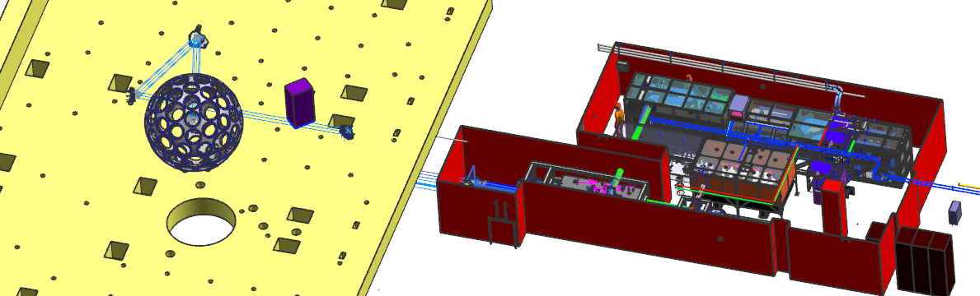
The FLUX program addresses laser and physics challenges related to broadband optical pulses
OMEGA Target Bay
Room 5101
Laser
Optical damage with spectrally incoherent pulses
Broadband transport and focusing
Gratings for efficient sum-frequency generation
Overall efficiency
Physics at relevant intensities
CBET and other laser-plasma instabilities
Laser imprint and hydro instabilities
Optimization of “bandwidth formats”

Slide 5
FLUX relies on parametric amplification and a novel sum-frequency-generation (SFG) scheme to generate spectrally incoherent, high-energy UV pulses
The FLUX laser development and experimental program spans multiple years:
Testing of sub-components and concepts in FY2019 and FY2020
Design and procurement in FY2020
Construction in FY2021
Activation with OMEGA in FY2022
LPI and uniformity experiments in FY2022 and FY2023

Slide 6
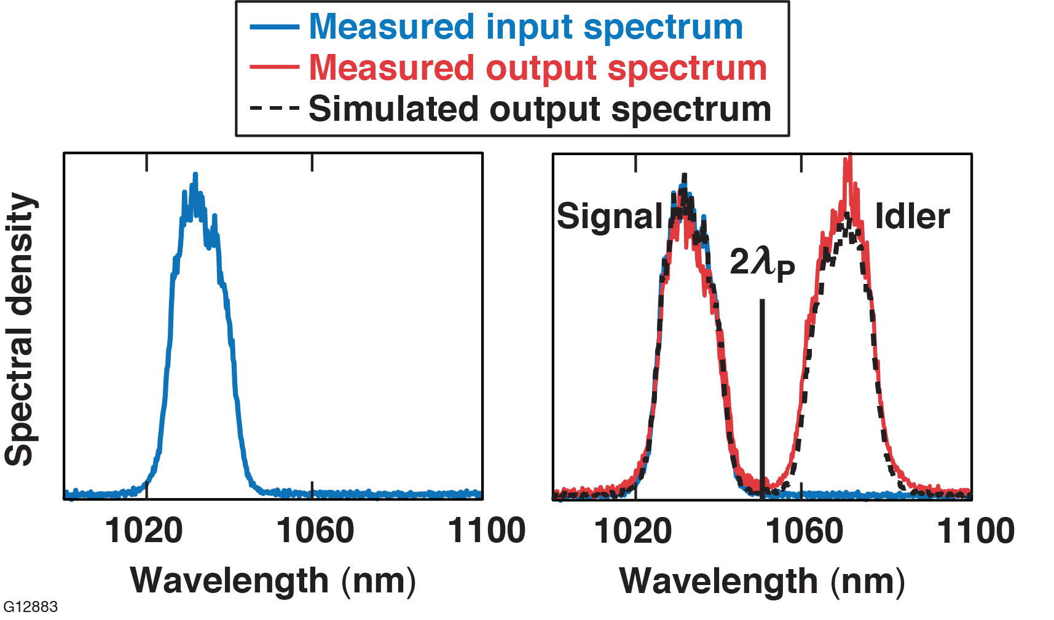
Optical parametric amplification (OPA) can generate broadband spectrally incoherent pulses around 1053 nm with efficiency > 70%
OPAs can deliver high-conversion efficiency and broadband output:
collinear operation close to spectral degeneracy: 2× energy and >2× bandwidth
70% energy transfer from pump to combined signal and idler beams

Slide 7
Sum-frequency generation in an angularly dispersed noncollinear geometry yields broadband operation
Three degrees of freedom
Phase mismatch for $\left(ω_{0}+{δω}_{1}\right)+\left(2ω_{0}\right)→\left({3ω}_{0}+{δω}_{1}\right)$
$D$: angular dispersion on 1$ω$ wave
$α$ : noncollinear angle between 1$ω$ and 2$ω$ waves
$θ$: crystal angle relative to optical axis
$$Δk\left({δω}_{1},θ,D,a\right)=Δk\left(0,θ,D,a\right)+ {\frac{∂Δk\left(0,θ,D,a\right)}{{∂ω}_{1}}δω}_{1}$$

Slide 8
Sum-frequency generation in an angularly dispersed noncollinear geometry yields broadband operation
$$\left|\frac{∂Δk\left[0,θ\left(α\right),D,α\right]}{{∂ω}_{1}}\right|$$
1-cm KDP
No detuning
Detuning = 300 $μ$rad
Detuning = 600 $μ$rad
> 10$×$ bandwidth increase over collinear SFG
> 10 THz bandwidth (Δω/ω₀ > 1%) in 1-cm KDP crystal

Slide 9
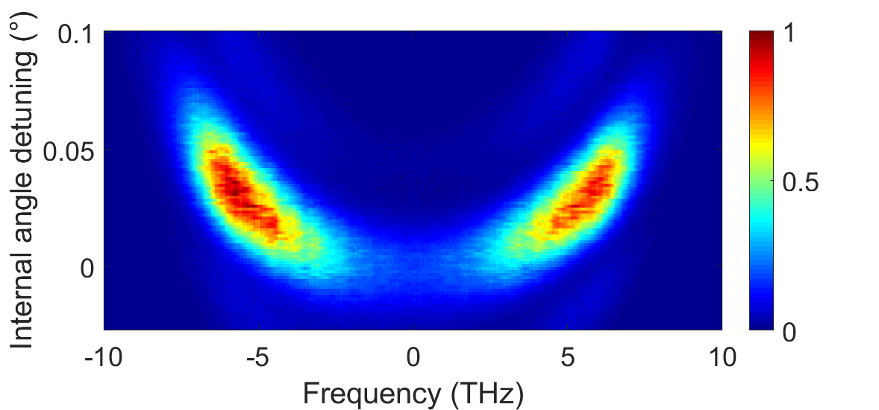
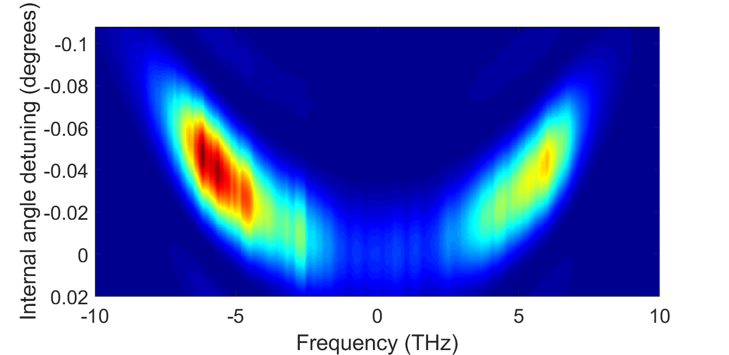
Operation with a spectrally incoherent 1ω input yields a broadband 3ω pulse
Measurement
Simulation
> 10$×$ bandwidth increase over collinear SFG
> 10 THz bandwidth (Δω/ω₀ > 1%) in 1-cm KDP crystal

Slide 10
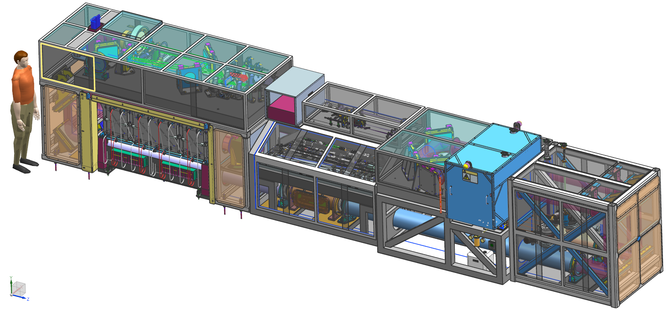
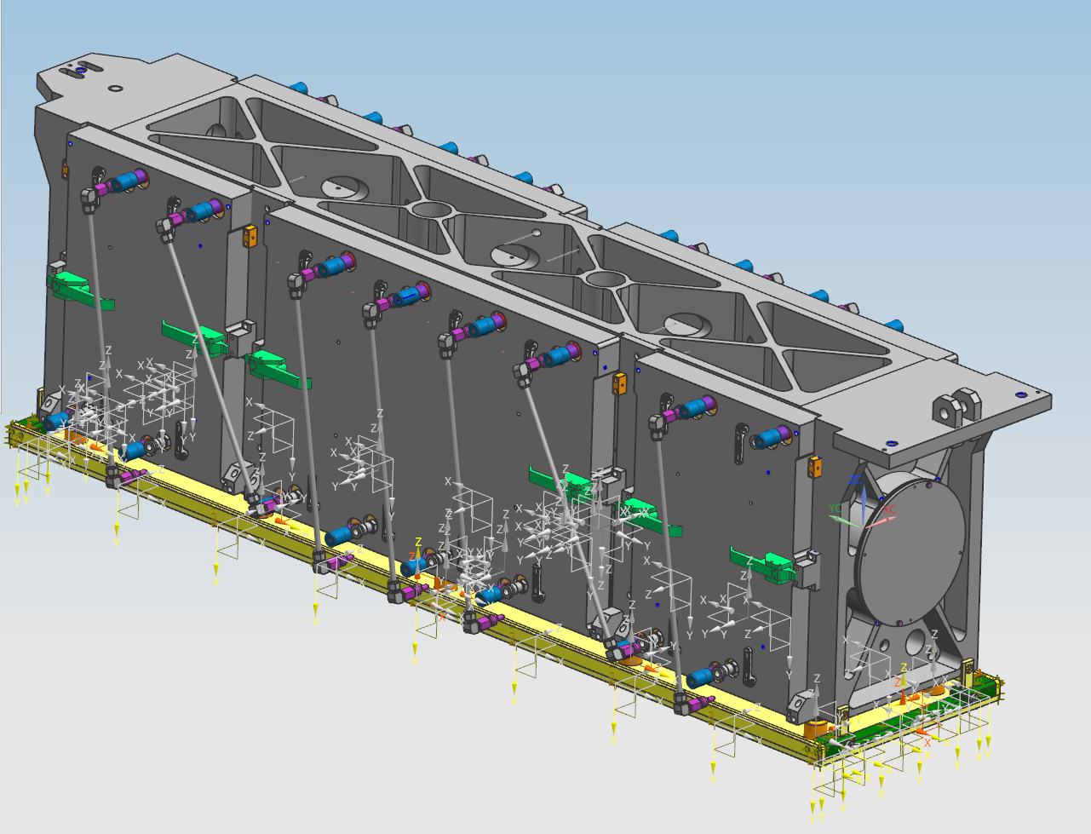
The LLE Active Multi-pass Imaging Cavity Amplifier (AMICA) laser integrates a complete beamline into a flexible package that can serve multiple purposes
AMICA configuration for FLUX COPA + SFG pump laser
AMICA-based FLUX pump laser | AMICA+ laser system plus booster amp
600 J (1ω) 400 J (2ω) | ~2 kJ (1ω) ~1.5 kJ (2ω)
2× 1.5 ns | 30+ ns
narrowband | Multi-FM SSD
Ship as-built (minus high-value optics)
LLE 20-cm disk amplifier
Modular construction
Dust tight enclosure
Space reserved for actively cooled disk amplifier modules for increased rep rate
Adding an AMICA cavity extension can support ~150-ns pulse lengths (AMICA+XL)
Notes:
L: 381 inch = 9.7 m = 31.75 feet
W: 52 inch = 1.3 m = 4.33 feet
W at PEPC: 64 inch = 1.6 m = 5.33 feet
H: 77 inch = 2.0 m = 6.42 feet
MEC pulse length requirements currently

Slide 11
The FLUX concept leverages existing technology to deliver broadband UV laser pulses for mitigating laser-plasma instabilities (LPI) and improving uniformity
Conclusions
The FLUX program will address laser and physics challenges related to broadband optical pulses
FLUX relies on optical parametric amplification OPA and a novel sum-frequency-generation (SFG) scheme to generate spectrally incoherent, high-energy UV pulses
OPA and SFG stages use large-aperture KDP crystals
Diffraction gratings developed for Laser Megajoule (LMJ) provide angular dispersion required for efficient SFG and beam smoothing
A new FLUX pump laser system leverages existing LLE laser technology
The FLUX pump laser along with a booster amplifier will be delivered to the Matter at Extreme Conditions (MEC) at SLAC
NNSA and FES funding (coordinated with the ARPA-E BETHE program) enables FLUX laser system development and LPI mitigation experiments on OMEGA

Slide 12
Backup slides

Slide 13
Parametric amplification of spectrally incoherent pulses has been tested on the Multi-TeraWatt (MTW) laser

Slide 14
The novel SFG scheme has been investigated on the FLUX testbed
Three degrees of freedom
$D$: angular dispersion on 1$ω$ wave
$α$ : noncollinear angle between 1$ω$ and 2$ω$ waves
$θ$: crystal angle relative to optical axis
Static
Tunable
Tunable

Slide 15
Solid-state laser drivers can produce the large fractional bandwidths required to mitigate laser-plasma instabilities
 | StarDriverTM | FLUX
Concept
Number of beamlines | 1,000s | 1 (in 2022)
Δω/ω (total) | 2% (existing glass) 10% (new glass development) | 1.5%
Δω/ω (per beamline) | 0.1% | 1.5%
Stimulated Rotational Raman Scattering (SRRS):
can be used to increase the bandwidth of solid-state and excimer lasers
is currently being studied in an NRL-LLE collaboration

Slide 16
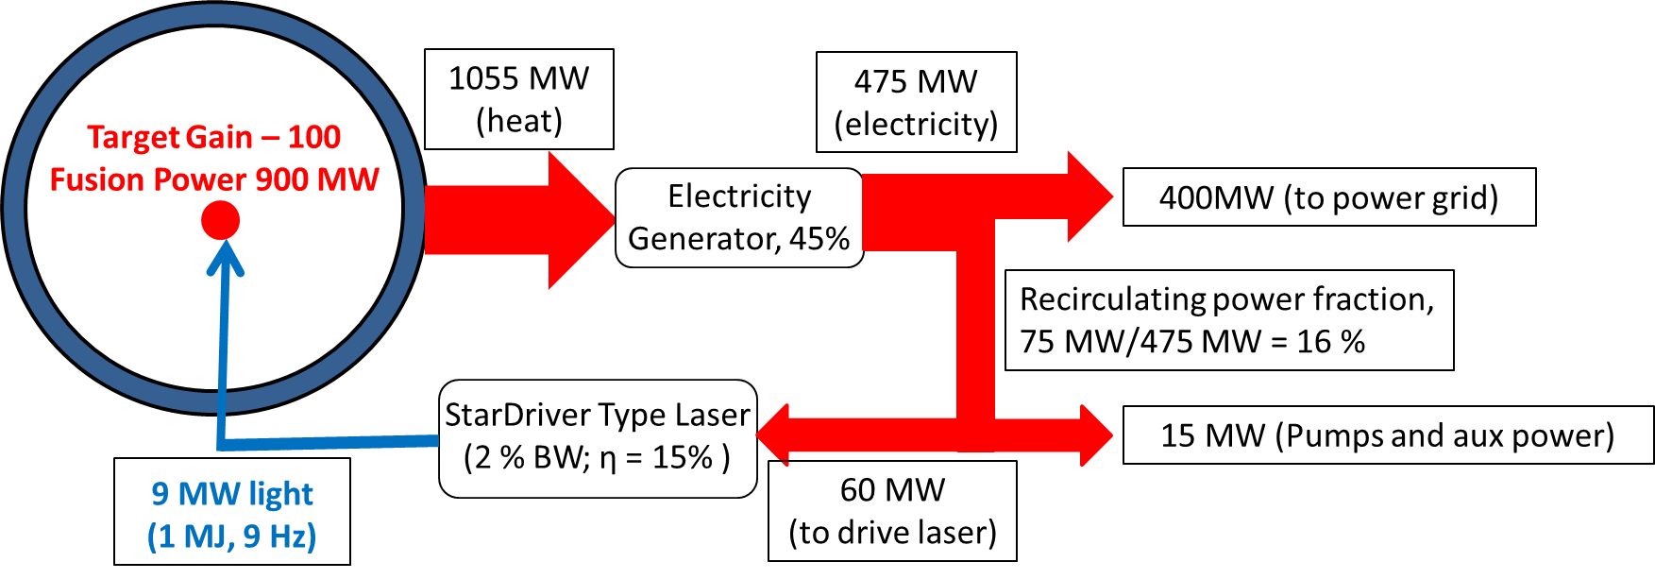
A diode-pumped broadband StarDriverTM (Δω/ω > 2%) is expected to support a 400-MW power plant with cost<$2B
Total direct costs | $1,123M
Laser system | $300M
Reactor plant | $203M
Balance of plant | $620M
Indirect costs | $674M
First demonstration of broadband spectrally-Incoherent, high-peak-power UV radiation, sufficient to enable the experimental validation of critical LPI suppression in IFE target designs suitable for commercial fusion power.
Current estimate for diode-pumped broadband StarDriverTM-based 400-MW power plant (based on LIFE cost analysis):
overnight capital cost: $1.8B
capital cost of electric power: 4.5 $/W
Will require more in-depth cost studies for various IFE approaches
Notes:
Key techno-economic metrics of the project (and, if applicable, its commercial fusion-energy application)

