Slide 1
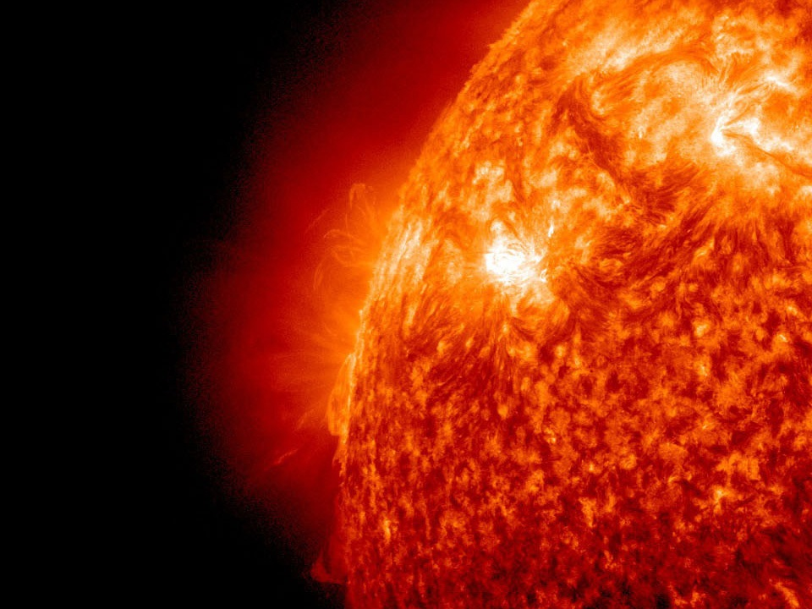
Innovation Network for Fusion Energy (INFUSE) Program Overview
Daniel Clark
Materials Program Manager
Office of Fusion Energy Sciences
Fusion Power Associates 41st Annual Meeting
December 17, 2020

Slide 2
Outline
Overview
Organization
Request For Assistance (RFA) Details
Award Statistics
Future Outlook

Slide 3
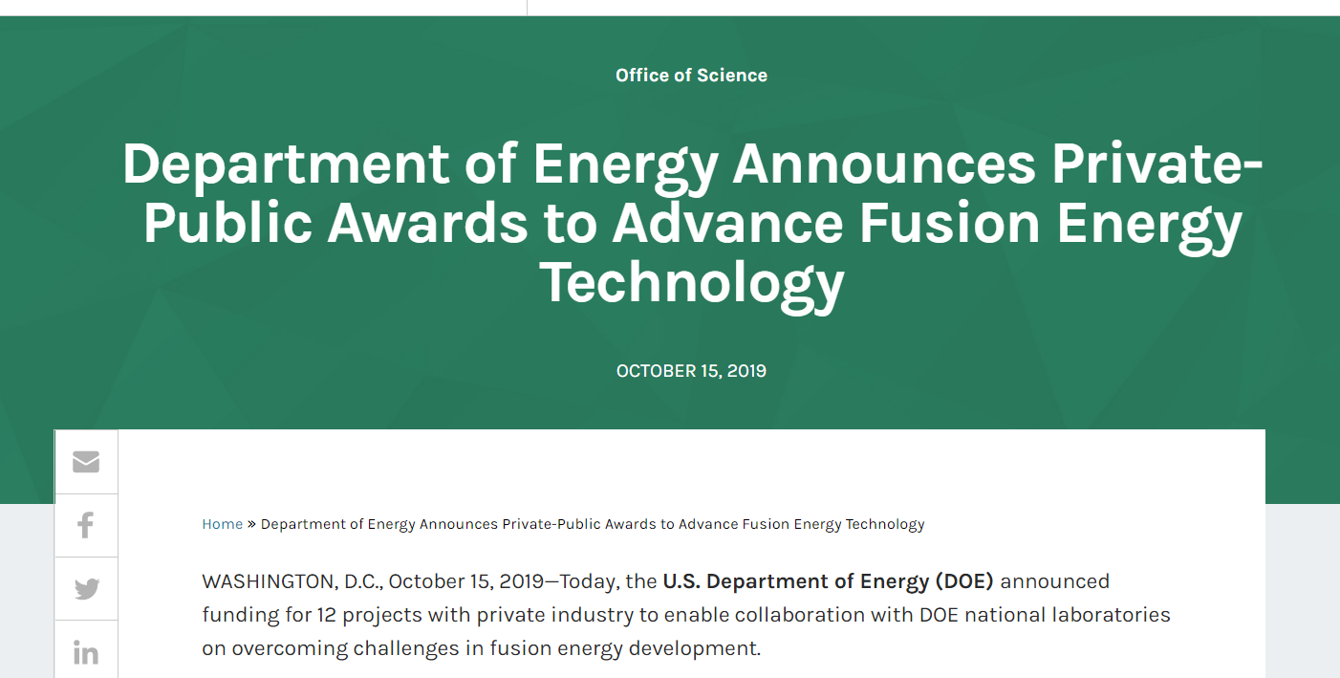
Program Overview
INFUSE program is a Public-Private Partnership (P3) Program started by FES with a Pilot Program in FY 2019.
Initiated due to the recent surge in private sector investment in fusion energy and the recognition that many unique and important capabilities are located at DOE National Laboratories.
Focused on providing a quick, streamlined approach for companies to access DOE Laboratory Capabilities.
The INFUSE Program is modeled after other successful DOE P3 programs, most notably the Gateway for Accelerated Innovation in Nuclear (GAIN) Nuclear Energy Voucher program established by the DOE Office of Nuclear Energy (NE), which has been very successful in providing the nuclear fission industrial community with access to the resources available across the DOE complex.
The Request for Assistance (RFA) Calls are managed by a consortium of FES funded laboratories, led by ORNL and PPPL.
This is first of a kind P3 program within the Office of Science.
https://www.energy.gov/science/articles/department-energy-announces-private-public-awards-advance-fusion-energy-technology
https://infuse.ornl.gov/

Slide 4
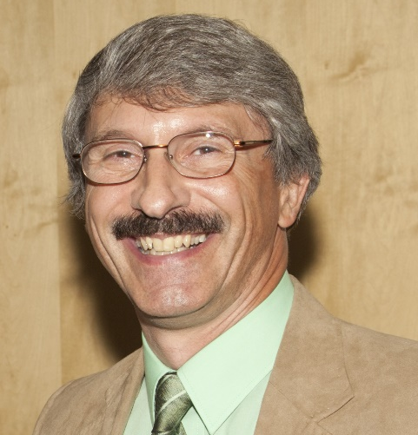
Program Organization
The DOE national laboratories possess expertise and capabilities in fusion research spanning over five decades of development. Currently, ten DOE laboratories participate in the INFUSE program. You may find their capabilities and contact information in the links below.
Laboratory | Point of Contact | Email
Brookhaven National Laboratory (BNL) | Ramesh Gupta | gupta@bnl.gov
Idaho National Laboratory (INL) | Paul Humrickhouse | paul.humrickhouse@inl.gov
Lawrence Berkeley National Laboratory (LBNL) | Steve Gourlay | sagourlay@lbl.gov
Lawrence Livermore National Laboratory (LLNL) | Andris Dimits | dimits1@llnl.gov
Los Alamos National Laboratory (LANL) | Glen Wurden | wurden@lanl.gov
Oak Ridge National Laboratory (ORNL) | Dennis Youchison* | youchisondl@ornl.gov
Pacific Northwest National Laboratory (PNNL) | Wahyu Setyawan | wahyu.setyawan@pnnl.gov
Princeton Plasma Physics Laboratory (PPPL) | Ahmed Diallo** | adiallo@pppl.gov
Sandia National Laboratories (SNL) | Rob Kolasinski | rkolasi@sandia.gov
Savannah River National Laboratory (SRNL) | Jim Klein | james.klein@srnl.doe.gov
Current Topical Areas:
Enabling Technologies
Materials Science
Plasma Diagnostics
Theory and Simulation
Experimental Capabilities
*Dennis Youchison-ORNL, INFUSE Director
**Ahmed Diallo-PPPL INFUSE Deputy Director
(NEW)
(NEW)

Slide 5
Request for Assistance (RFA) Details 1
Scope
Funding goes directly to a DOE laboratory to perform a scope of work in support of the requesting company
Focused on basic research, not commercialization
Focused on unique capabilities at DOE laboratories, not items readily available elsewhere
A single institution may submit up to five RFA’s to a single RFA call (NEW)
Budget and Schedule
Majority of requests are for single year awards with a value of between $50k - $250k
In special cases, applicants may request up to $500k in total value with a duration of up to two years (NEW)
20 percent cost share is required, which can be cash, equipment, or in-kind contributions
Company Certification
Requestors must certify that they will accept one of the two standardized Cooperative Research and Development Agreements (CRADAs)
Requestors must certify that they will provide the required 20 percent upon selection for a partnership award

Slide 6
Request for Assistance (RFA) Details 2
Eligible Requester
U.S. based private entity with U.S. ownership
U.S. based private entity with foreign ownership so long as that entity’s participation is in the economic interest of the U.S. (NEW)
RFA Execution Requirements
All work under an INFUSE award must be performed in the U.S.
Products embodying intellectual property developed under the assistance must be substantially manufactured in the U.S.
The transfer of technology and data resulting from INFUSE awards are subject to U.S. export control laws.
Merit Review
The Review Process is organized by the INFUSE Team at ORNL/PPPL, with input provided to FES for final selection
RFA applications are evaluated and competitively selected in accordance with the Office of Science Review Criteria
Reviewers are asked to comment on the value of the work from the company perspective
More details available: https://infuse.ornl.gov/rfa-announcement-and-submission/
Award Abstracts: https://infuse.ornl.gov/?s=abstract&filter=&ls=

Slide 7
Request Details (Continued)
 | Requests | Awards | Rate
All RFA's | 62 | 31 | 50%
FY19 | 21 | 11 | 52%
FY20-A | 25 | 10 | 40%
FY20-B | 16 | 10 | 63%
SNL and SRNL added in FY20
Only PNNL and SNL have not yet been requested

Slide 8
Request Details (Continued)
 | Requests | Awards | Rate
All RFA's | 62 | 31 | 50%
FY19 | 21 | 11 | 52%
FY20-A | 25 | 10 | 40%
FY20-B | 16 | 10 | 63%
FY19 RFA Call included restriction of one request per topical area

Slide 9
Funding Statistics
 | Total Requested | Total Awarded | Average Size
All RFA's | $10,777 K | $5,642 | $177
FY19 | $2,870 | $1,543 | $137
FY20-A | $4,481 | $1,949 | $179
FY20-B | $3,426 | $2,150 | $214
FY20 RFA Calls increased the funding level to $500k total

Slide 10
Company Diversity
 | Total Requests | Unique Requesters | Unique Awardees
All RFA's | 62 | 21 | 13
FY19 | 21 | 11 | 5
FY20-A | 25 | 13 | 6
FY20-B | 16 | 10 | 8
One Company was selected in FY19 but ultimately declined due to cost-share complications
Of the 7 other companies who were unawarded, 5 only submitted once

Slide 11
Future Outlook
FES and the INFUSE Team are continuing to evaluate the INFUSE Program moving forward to ensure success
First round of Awards are ending in the next few months- Awardees will submit final reports, including highlight, publications, and other metrics of success
Two INFUSE Workshops have been held to help bring the labs and private industry together as well as to provide feedback on room for improvement
FY21 Workshop was cohosted by FES, the Electric Power Research Institute (EPRI), and the Fusion Industry Association (FIA)
Included over 195 Participates from private companies, DOE laboratories, universities, international organizations and utilities
FES is considering additional modifications to meeting company needs
FES is actively exploring other opportunities for more readily engaging private industry

Slide 12
Questions
daniel.clark@science.doe.gov
infuse@ornl.gov

